Slide 1




Banking Analytics
Banking Analytics: Customer Segmentation & Risk Insights Report
A comprehensive analysis of customer behavior, loan distribution, deposit patterns, and risk insights to drive strategic banking decisions and sustainable growth.
Presented by: Md Najish

Slide 2

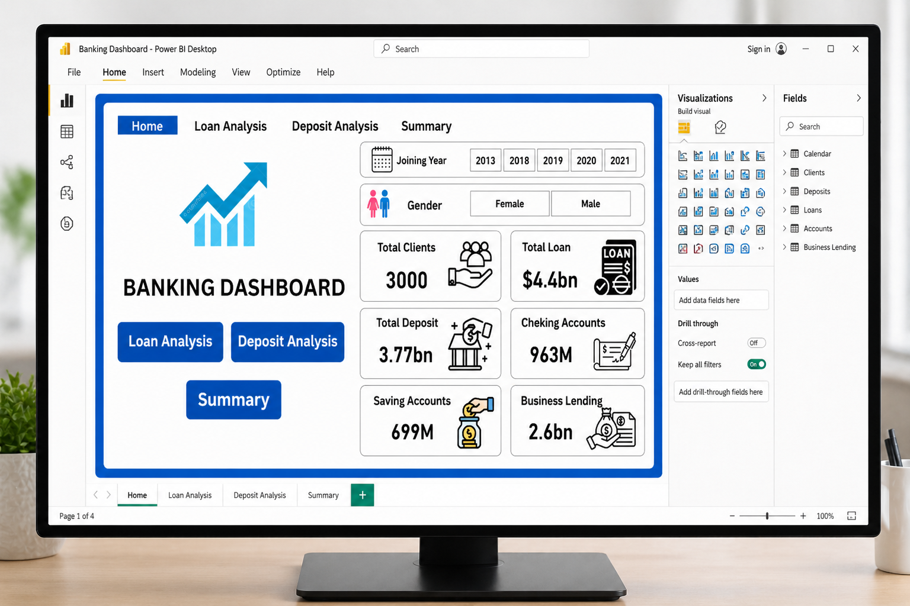

Project Overview
This report analyzes a comprehensive banking dataset using Python, SQL, and Power BI. Our focus centers on customer behavior patterns, loan portfolios, deposit trends, and overall financial performance. Interactive dashboards deliver key banking metrics and actionable insights.

Slide 3



Banking Analytics Report
Business Problem Statement
The bank is managing large volumes of loans and deposits but lacks clarity on:
Which customer segments drive revenue
Risk distribution across loan categories
Deposit vs loan balance efficiency
Customer demographics impact (gender, income, nationality)

Slide 4

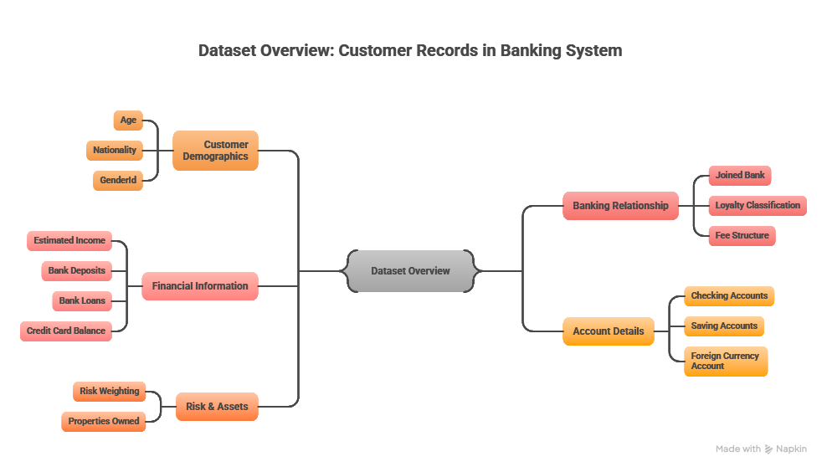
Banking Analytics Report

Slide 5


Banking Analytics Report
Project Objectives
Goals
Analyse total loans and deposits
Identify high-value customer segments
Evaluate loan distribution across income bands
Understand demographic impact on banking products
Provide insights for risk and growth optimization

Slide 6
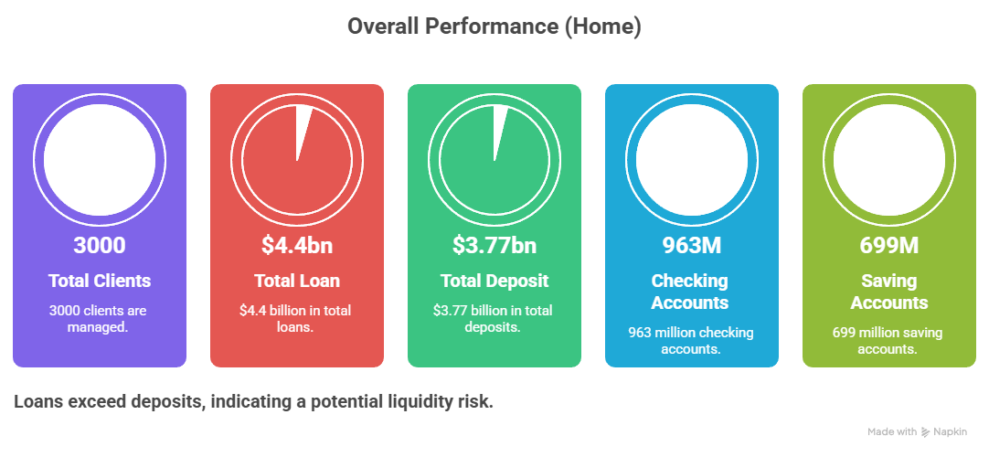
Banking Analytics Report

Slide 7

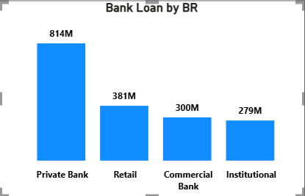
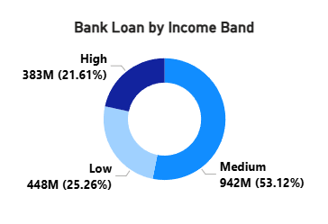
Banking Analytics Report
Key Insights — Loan Analysis
Private Bank segment leads with approximately $814M in loans, followed by Retail and Commercial segments. Medium income customers dominate the loan portfolio at 53%, creating concentration risk. This uneven distribution increases risk exposure and highlights the need for portfolio diversification strategies.

Slide 8
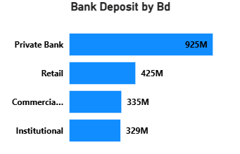
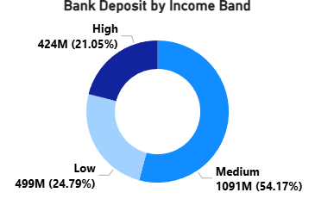
Banking Analytics Report
Key Insights — Deposit Analysis
Private Bank segment leads deposits with approximately $925M, demonstrating strong high-net-worth customer relationships. Medium income customers contribute the majority at ~54% of total deposits. This concentration reveals over-dependence on mid-income segments, creating vulnerability to market shifts affecting this demographic.

Slide 9
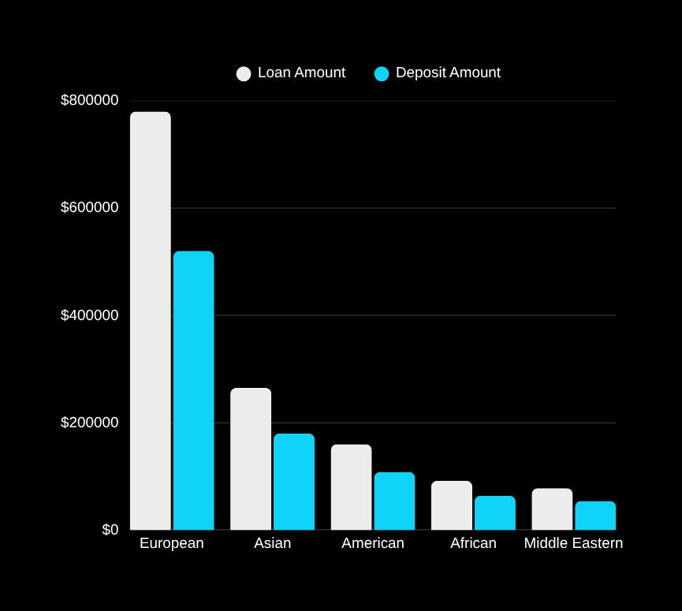
Banking Analytics Report
Key Insights — Demographic Insights
European customers dominate both loans and deposits, representing the majority of banking activity. Occupation categories show uneven distribution across segments. This reveals limited diversification in the customer base, creating concentration risk.

Slide 10


Banking Analytics Report
Key Business Problems Identified
This analysis reveals critical challenges: Loan-to-Deposit imbalance creates liquidity risk ($4.4B loans vs $3.77B deposits). High dependency on medium-income customers (53-54% of portfolio). Concentration risk in Private Banking segment. Limited diversification across nationality and occupation categories. Uneven loan distribution signals potential credit risk exposure.

Slide 11


Banking Analytics Report
Recommended
Solutions
• Improve Deposit Mobilization: Launch high-interest
savings products and target new customer segments
• Diversify Loan Portfolio: Expand
underrepresented segments and reduce private
banking dependency
• Strengthen Risk Management: Monitor loan
concentration and implement stricter credit policies
• Customer Segmentation Strategy: Target low and
high income groups with personalized products
• Market Expansion: Focus on underrepresented
nationalities through targeted outreach campaigns

Slide 12

Banking Analytics
Tools Used
MS Excel for data preparation and exploration. SQL for data querying and extraction. Power BI for interactive dashboard visualization. Python for advanced data analysis and modeling.

Slide 13

Banking Analytics Report
Conclusion & Next Steps
This analysis reveals critical liquidity imbalance and customer concentration risks requiring strategic action. Recommendations focus on deposit growth, portfolio diversification, and targeted segmentation to support sustainable growth and risk reduction. We welcome your questions and discussion.

